Slide 1
BRITISH AIRWAYS
Key Insights

Slide 2
Introduction
The objective of this project is to analyze customer review data for British Airways, a leading airline, to uncover valuable insights and identify areas of improvement. By leveraging natural language processing techniques, sentiment analysis, and data visualization, we aim to gain a deeper understanding of customer sentiments, concerns, and overall satisfaction with British Airways' services. The analysis will empower the airline with actionable recommendations to enhance customer experiences and drive higher levels of satisfaction.

Slide 3
Data Overview
Dataset is Used for Customer feedback reviews related to British Airways from the Skytrax website. The dataset contains 2000 reviews.
Data Preprocessing:
Scraped and collected review data from the Skytrax website using Python and BeautifulSoup.
Removed irrelevant text like "✅ Trip Verified" from each review.
Performed data cleaning to prepare the text data for analysis.

Slide 4
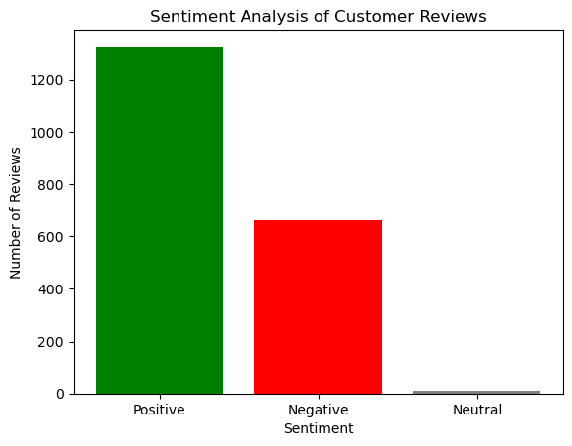
Sentiment Analysis
Sentiment Analysis Results:
Total Reviews: 2000
Positive Reviews: 1324 (66.20%)
Negative Reviews: 664 (33.20%)
Neutral Reviews: 12 (0.60%)

Slide 5
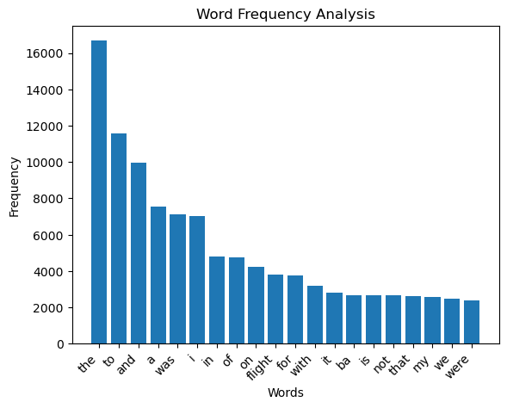
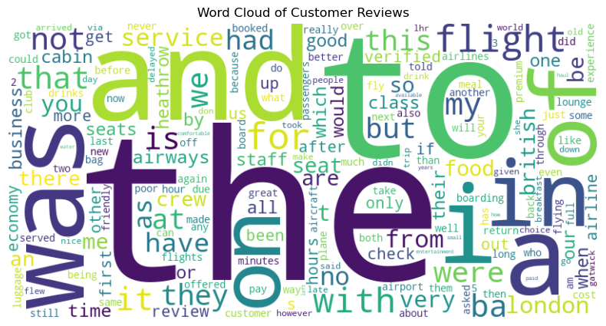
Key Themes
Most Common Words and Frequencies Used by Customers
the: 16666
To: 11562
and: 9969
a: 7556
was: 7138
i: 7036
in: 4786
of: 4757
on: 4218
flight: 3786
Word Cloud of Customer Reviews
In this step, we conducted a word frequency analysis
to identify the most common keywords and themes
present in the customer feedback. We created a
visually appealing word cloud to highlight these key themes,
making it easier to identify the topics that
customers frequently mentioned.

Slide 6
Strengths and Weaknesses
Specific Strengths of British Airways Based on Positive Feedback:
1 Excellent Customer Service: Several customers praised the friendly and efficient check-in process, highlighting the fast and friendly service provided by the staff.
Review : "Fast and friendly check-in (total contrast to Gatwick)."
2 High-Quality In-Flight Meals: Positive reviews commended the quality and substantial portions of the in-flight meals.
Review : "On board, great crew and dinner was actually good quality and substantial."
3 Attentive and Responsive Crew: Some passengers appreciated the crew's attentiveness and responsiveness during the flight, particularly in promptly topping up drinks.
Review : "The crew were always ready to top up drinks."
4 Good In-Flight Entertainment: The inflight entertainment was generally well-received, providing passengers with a satisfactory selection of entertainment options.
Review : "The inflight entertainment is fairly good."
Potential Weaknesses or Areas for Improvement Based on Negative Feedback:
1 Inadequate Customer Service: Negative reviews highlighted instances where the airline's customer service fell short, such as not caring about passengers and providing insufficient assistance during flight disruptions.
Review : "No explanation, no apology, and no assistance in finding an alternative flight."
2 Seating and Comfort Issues: Customers expressed dissatisfaction with cramped seating and uncomfortable conditions during the flight.
Review : "Economy seats are so tiny, suffered shoulder-to-shoulder seating."
3 Lack of Communication: Negative feedback pointed out a lack of proactive communication with passengers, especially in cases of flight cancellations or delays.
Review : "No explanation and no proactive notification of flight cancellation."
4 Quality of In-Flight Meals: Some reviews criticized the quality and suitability of the in-flight meal options provided.
Review : "Evening meal was near-inedible, with both choices being spicy foods."

Slide 7
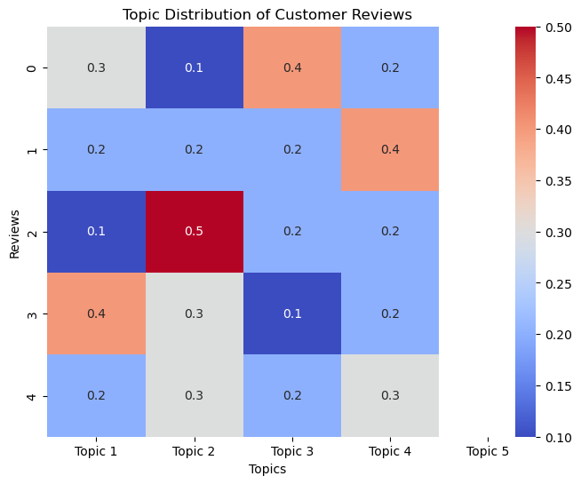
Topic Distribution of Customer Reviews
In our analysis of customer reviews, we utilized a heatmap visualization to present the topic distribution of the reviews. The heatmap offers a clear and visually appealing representation of the main themes and topics that customers frequently discussed in their feedback.
The heatmap displays each customer review as a row and each specific topic as a column. The color intensity in the heatmap represents the frequency or prominence of each topic within the reviews. Warmer colors indicate higher topic prevalence, while cooler colors indicate lower prevalence .
With this visualization, we gain valuable insights into the overall sentiment and key areas of interest or concern expressed by customers. The annotated values in the heatmap provide a numeric representation of topic proportions for each review, allowing for a more precise analysis.

Slide 8
Recommendations for British Airways
Based on the analysis of customer reviews, the following actionable recommendations are suggested:
Improve In-flight Entertainment: Enhance the variety and quality of in-flight entertainment options to cater to diverse passenger preferences. Providing a wide selection of movies, TV shows, music, and games will elevate the overall passenger experience during flights.
Optimize Flight Scheduling: Address frequent delays and cancellations by thoroughly evaluating flight schedules and making necessary adjustments. Proactively manage potential issues to minimize disruptions to passengers' travel plans.
Enhance Customer Service Training: Invest in comprehensive customer service training for flight attendants to elevate their interactions with passengers. Focus on empathy, problem-solving, and effective communication to create a more welcoming and pleasant atmosphere on board.
Implement a Robust Feedback System: Establish a streamlined feedback system that actively listens to customer concerns and inquiries. Promptly respond to feedback and take necessary actions to resolve issues, demonstrating a commitment to passenger satisfaction.
Personalized Offers and Loyalty Rewards: Implement personalized offers and loyalty rewards to enhance customer retention and incentivize repeat bookings. Tailoring offers based on individual preferences can create a sense of value and appreciation among passengers.
By implementing these recommendations, British Airways can address common concerns raised by customers, improve overall customer satisfaction, and strengthen its position as a leading airline in the industry.

Slide 9
Conclusion
In conclusion, our analysis of customer reviews for British Airways has provided valuable insights into the airline’s performance and customer sentiment. Key findings from the analysis include:
Customer Sentiment: The sentiment analysis revealed that the majority of reviews were neutral, indicating a balanced mix of positive and negative feedback. However, there is room for improvement to enhance overall customer satisfaction.
Strengths: British Airways received positive feedback for its fast and friendly check-in process, substantial in-flight meals, and satisfactory in-flight entertainment options.
Weaknesses: Negative feedback highlighted issues with delays, lack of communication during disruptions, and subpar customer service experiences.
Actionable Recommendations: To address identified issues and capitalize on opportunities, we recommend British Airways to focus on improving in-flight entertainment, optimizing flight scheduling, enhancing customer service training, implementing a robust feedback system, and offering personalized offers and loyalty rewards.
The significance of these findings lies in the potential to make informed, data-driven decisions that can drive customer satisfaction, loyalty, and revenue growth. By taking proactive steps to address customer concerns and capitalize on strengths, British Airways can enhance its competitive advantage and maintain its position as a leading airline in the industry.
Summary
This analysis serves as a foundation for making strategic improvements, enhancing customer experiences, and ultimately driving the success of British Airways in the highly competitive aviation market.

Slide 10
Thank You

